Slide 1
This Is Their Life: Arthropods!

Slide 2
Notes:
We’re going to be talking about the life cycles of arthropods today. But first, we have to figure out what animals we’re talking about. So, here are the five main groups of animals scientists call arthropods:

Slide 3
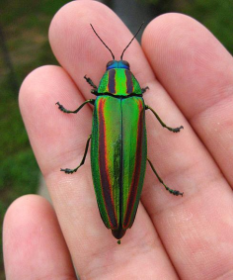
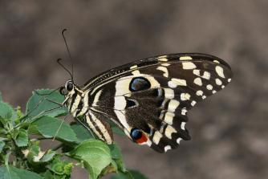
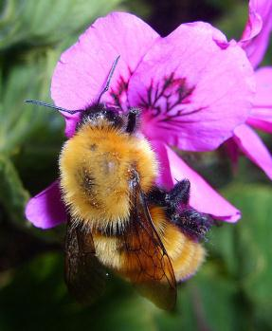
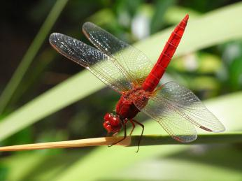
This Is Their Life: Arthropods!
Insects

Slide 4
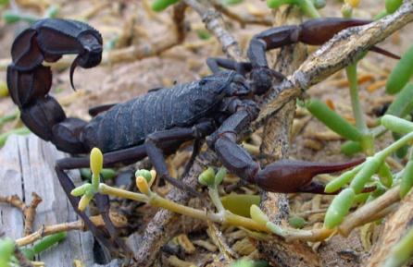
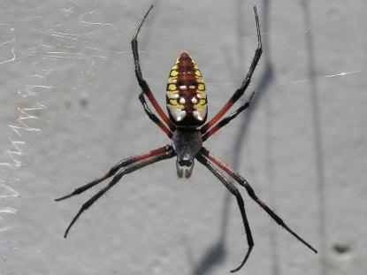
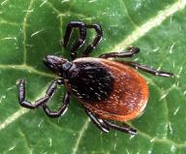
This Is Their Life: Arthropods!
Arachnids

Slide 5
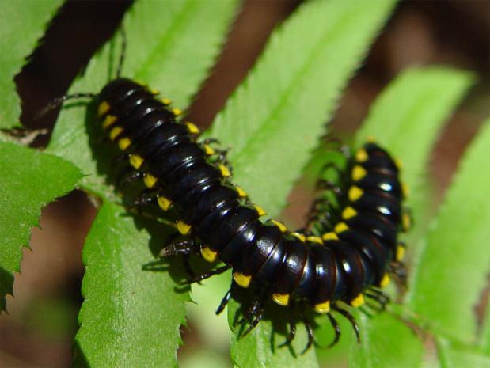
This Is Their Life: Arthropods!
Millipedes

Slide 6
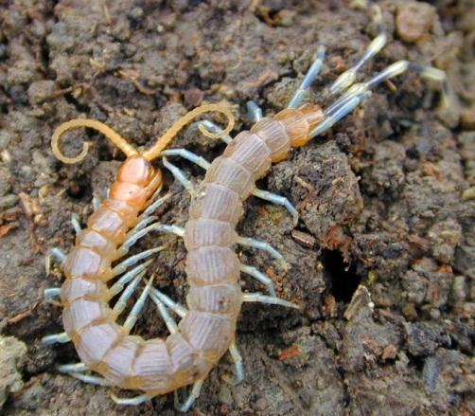
What Makes a “Bug?”
Centipedes

Slide 7
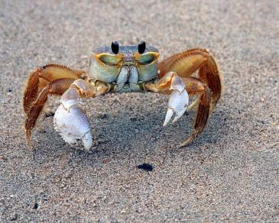
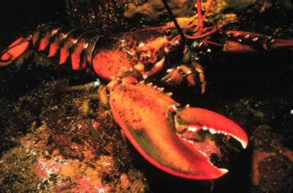
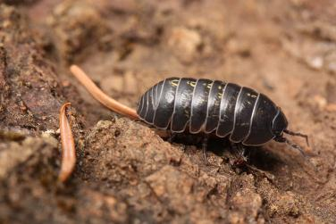
This Is Their Life: Arthropods!
Crustaceans

Slide 8
Notes:
Now we know what animals are arthropods, but we still need to know why each of these groups are classified as that. So, here are the three main characteristics that make an animal an arthropod:

Slide 9
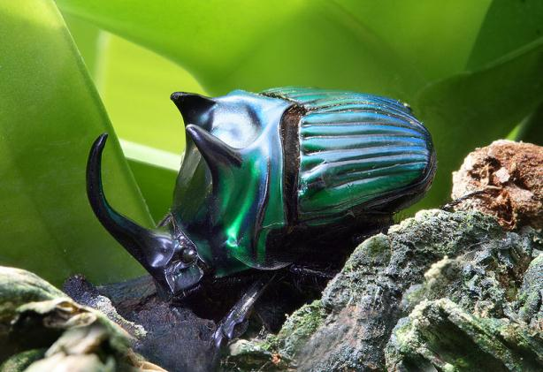
This Is Their Life: Arthropods!
First:
An exoskeleton
Notes:
An arthropod doesn’t have bones on the inside of its body like you and I. Instead, it has a hard outer shell called an exoskeleton. It gives the animal shape and structure; provides places for muscles to attach; and can help protect the animal against predators. But, the exoskeleton is hard, so it can’t grow or stretch as the arthropod grows. Instead, the arthropod has to molt its exoskeleton as it grows.

Slide 10
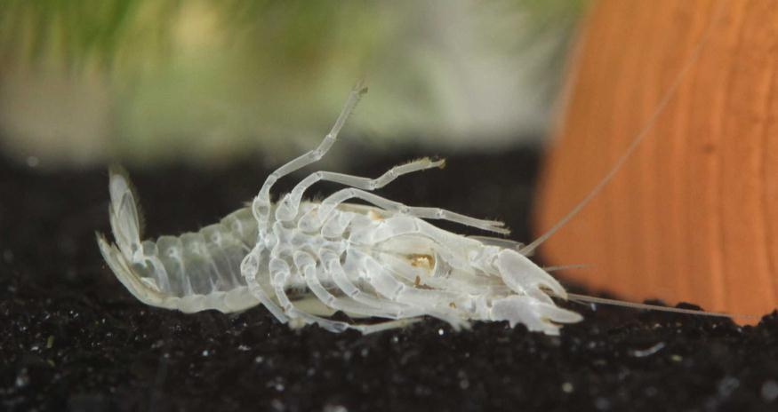
This Is Their Life: Arthropods!
Notes:
This is the old, molted exoskeleton of a crayfish.

Slide 11
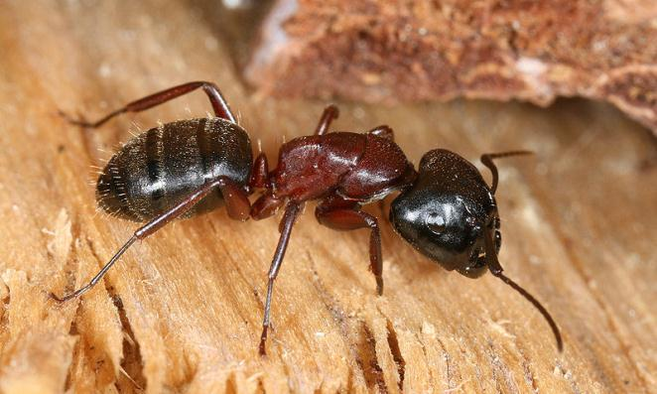
This Is Their Life: Arthropods!
Second:
Segmented body
Notes:
This ant has very distinct body segments. All insects have three segments, the head, thorax, and abdomen. Other arthropods have different numbers of segments. (Some large millipedes may have more than 100!)

Slide 12
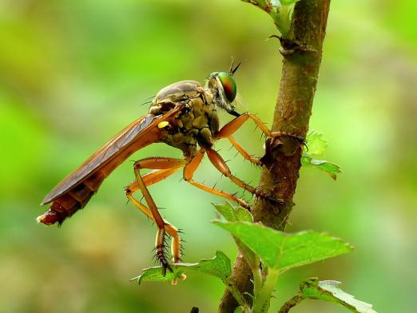
This Is Their Life: Arthropods!
Third:
Jointed appendages
Notes:
An appendage is anything that sticks off the body or head of an animal, such as arms, legs, tails or antennae. This dragonfly has very sturdy-looking legs with plenty of joints.

Slide 13
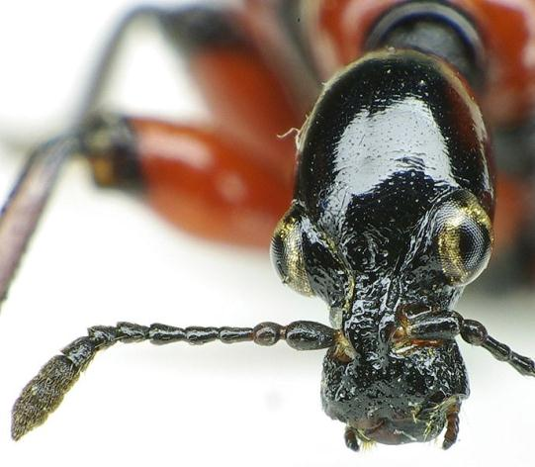
This Is Their Life: Arthropods!
Notes:
Here’s an example of another jointed arthropod appendage: the head of a European beetle. Note the joints in the antenna!

Slide 14
Notes:
Ok, we know what an arthropod is now. But today we’re going to talk about their life cycles. When we think of the life cycle of an insect, we usually think of something called metamorphosis. Let’s see what that means:

Slide 15
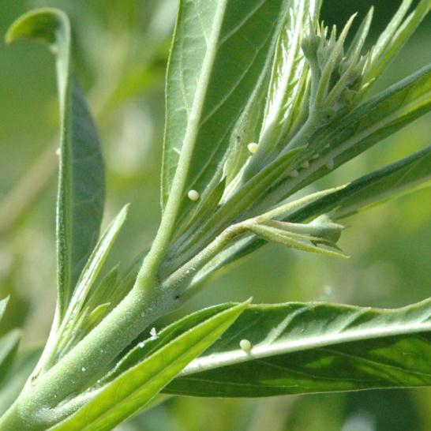
This Is Their Life: Arthropods!
Notes:
An arthropod generally starts its life as an egg. Where are the eggs in this picture? Anyone know what these might be the eggs of?

Slide 16
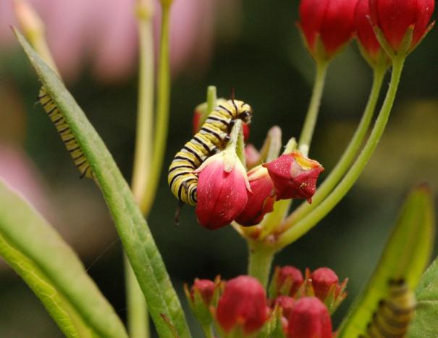
This Is Their Life: Arthropods!
Notes:
They’ll hatch out into these little caterpillars. Do you think the insect is going to look much like a caterpillar when it grows up?

Slide 17
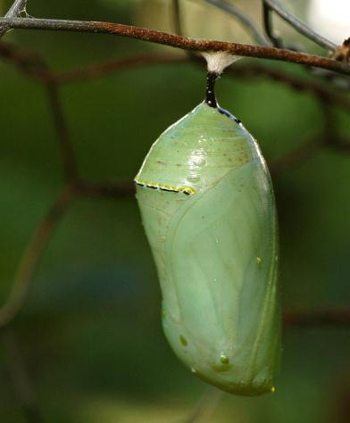
This Is Their Life: Arthropods!
Notes:
It won’t – but it has to do some changing first. Inside this chrysalis, one of those caterpillars is metamorphosing, or changing form.

Slide 18
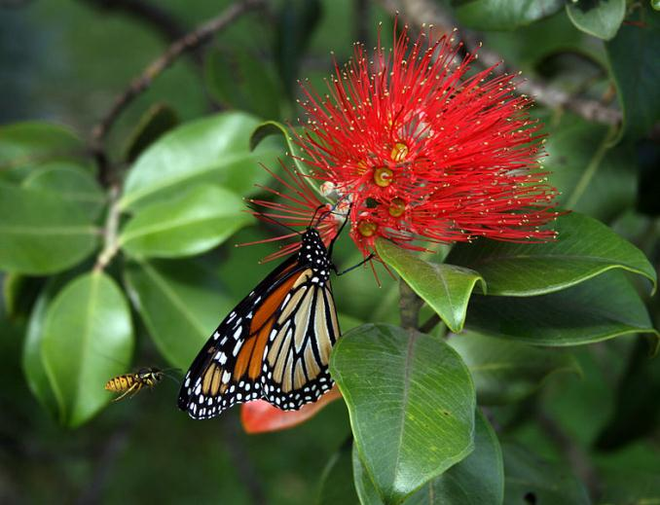
This Is Their Life: Arthropods!
Notes:
Into this, a Monarch butterfly!

Slide 19
Notes:
A lot of arthropods go through metamorphosis, but not all. We’re going to be meeting a couple of arthropods who don’t, so let’s see what that looks like.

Slide 20
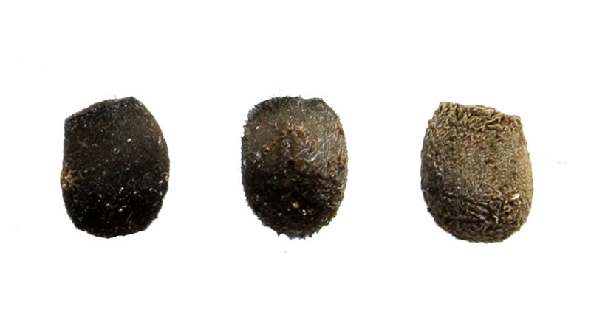
This Is Their Life: Arthropods!
Notes:
These are the eggs of a different arthropod, called a Brunei stick insect. They’re on this white background because they’re so hard to see down in the soil where the mother insect hides them.

Slide 21
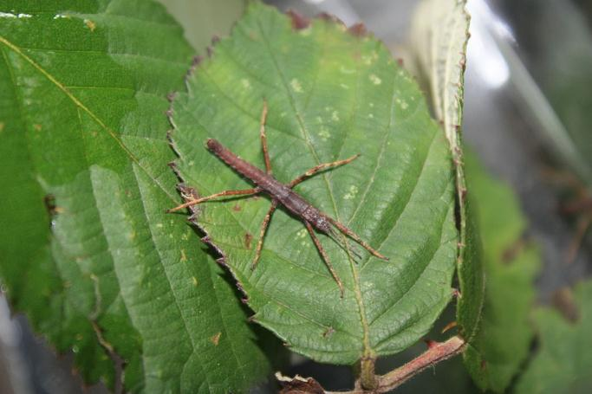
This Is Their Life: Arthropods!
Notes:
When they hatch out, they’re just tiny little stick insects called nymphs. Let’s see what they’ll look like grown up:

Slide 22
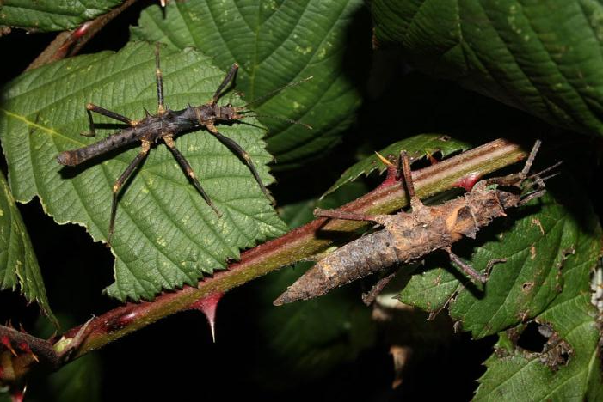
This Is Their Life: Arthropods!
Notes:
The leaves these adults are on are about the same size as the leaf that nymph was on, so you can see the size difference. There’s another size difference between these two as well, because they’re different sexes. The small one is male, and the big one is female.

Slide 23
Notes:
So, let’s meet the first of our two arthropods and go through what the course of that animal’s life would be like.

Slide 24
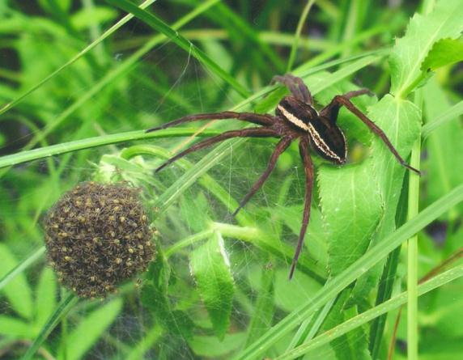
This Is Their Life: Arthropods!
Notes:
Here’s a mother spider with all her babies. These babies will go off on their own pretty quickly – most arthropods don’t provide a lot of parental care, so they have lots and lots of babies instead, and a few of them manage to survive.

Slide 25
Notes:
If an animal is going to survive, it’s going to have to find something to eat. So what do arthropods eat?

Slide 26
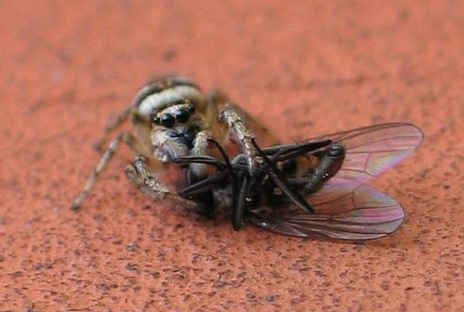
This Is Their Life: Arthropods!
Notes:
Spiders, like this one and our guest, are carnivorous predators. That means they hunt other animals for food.

Slide 27
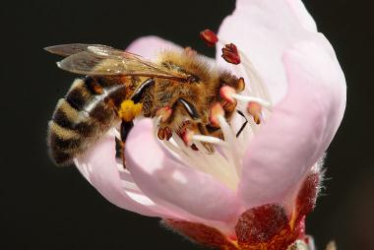
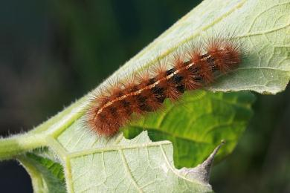
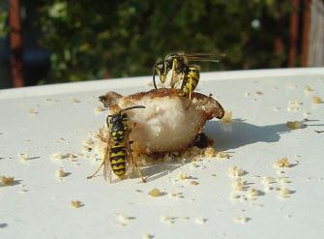
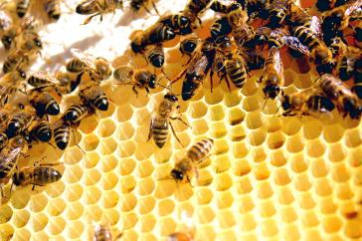
This Is Their Life: Arthropods!
Notes:
But different arthropods eat lots of different things. And some arthropods’ eating habits are incredibly important to us. (Talk about species brought.)

Slide 28
This Is Their Life: Arthropods!
Notes:
Or this guy eating Douglas-fir needles.

Slide 29
Notes:
The next thing an arthropod needs to do is have a way to protect itself. Is this arthropod doing anything to protect itself?

Slide 30
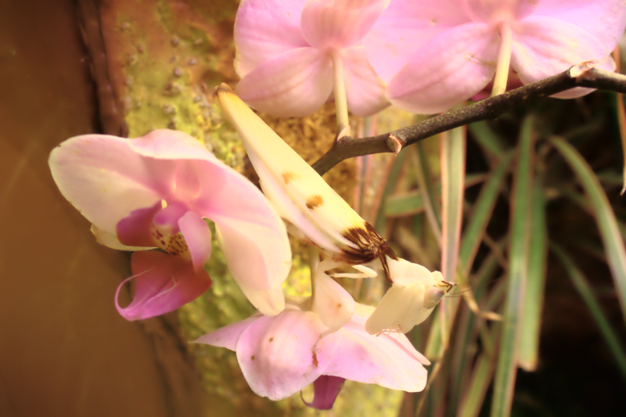
This Is Their Life: Arthropods!
Notes:
Can you even find the arthropod? It’s an orchid mantis, hiding from both prey & predators.

Slide 31
This Is Their Life: Arthropods!
Notes:
This scorpion uses its venom to catch prey, but can also ward off a lot of predators with it.

Slide 32
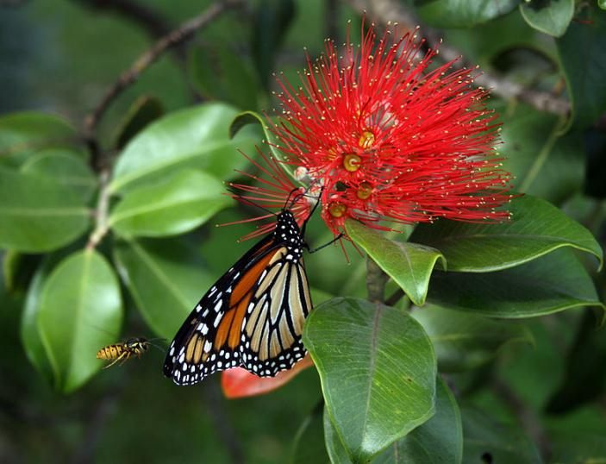
This Is Their Life: Arthropods!
Notes:
Remember this butterfly? Not a lot of birds will eat these, thanks to those bright colors warning them of how bad monarchs taste!

Slide 33
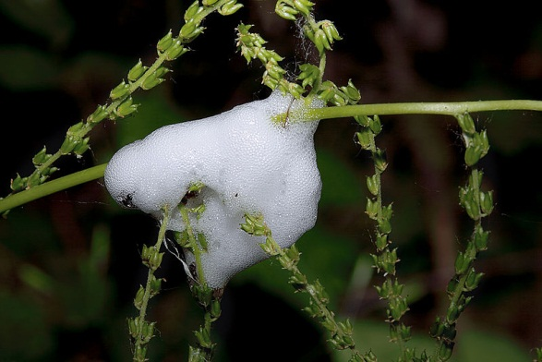
This Is Their Life: Arthropods!
Notes:
And this little guy isn’t likely to even be seen, all hidden in a cloud of his own spit!

Slide 34
Notes:
Once a bug grows up, the next thing it needs to do is reproduce – have some babies, that is! Most arthropods lay eggs, but not all in the same places.

Slide 35
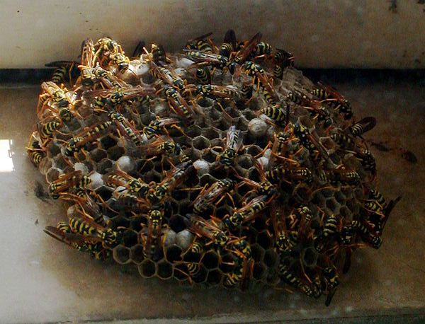
This Is Their Life: Arthropods!
Notes:
In bees and wasps, many species have a hive with special chambers. The queen lays an egg in each chamber, and the workers feed and care for the eggs and the larva that hatch from them until they’re grown up.

Slide 36
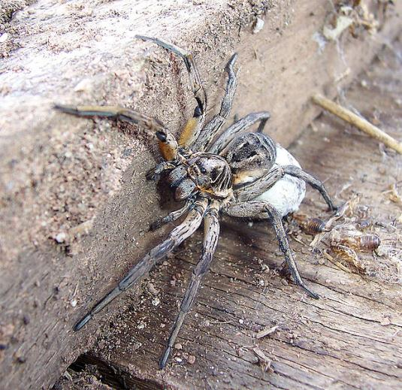
This Is Their Life: Arthropods!
Notes:
This mother spider is protecting her eggs. She’s wrapped them up in silk to keep them together and protect them from the elements, and she’ll stay with them until they hatch.

Slide 37
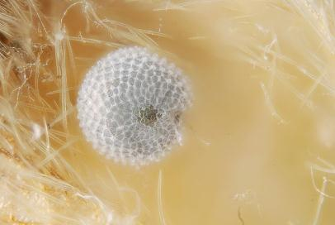
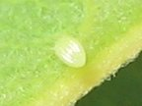
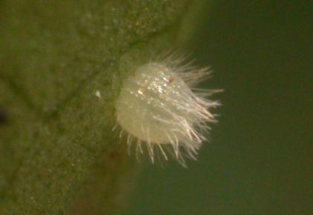
This Is Their Life: Arthropods!
Notes:
But, some arthropod eggs don’t get much protection, other than their own camouflage and their mother laying them carefully in a protected spot. These are three different species of butterfly eggs, all on the underside of various plants that will be good food for the new-hatched caterpillars.

Slide 39
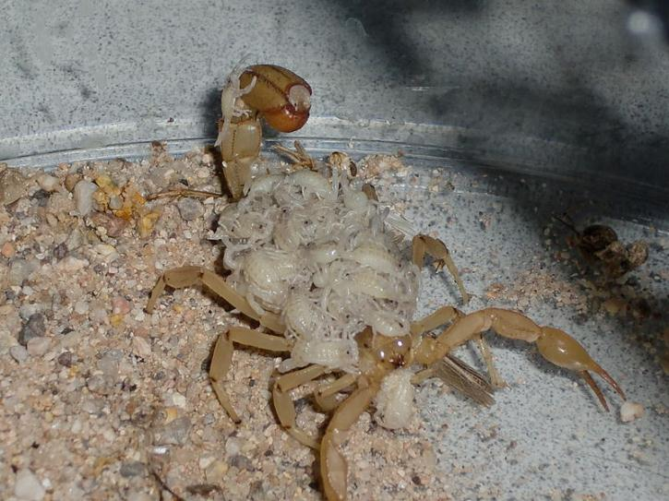
This Is Their Life: Arthropods!
Notes:
Interesting aside: most arthropods don’t provide much care for babies. Bees and wasps are one exception, and this is another: scorpions!

Slide 41
All photos in the public domain except as follows:
Used under a Creative Commons Attribution Share-Alike 3.0 license:
“Black scorpion” by Dbenbenn
“Armadillidium vulgare 2418” (pillbug) by Walter Siegmund
“Centipede” by John Hill
“Harpaphe haydeniana” (cyanide-producing millipede) by Franco Folini
“Oxysternon conspicillatum male” (rhinoceros beetle) by Richard Bartz
“Oman centipede” by Moayed Bahajjaj
“Apoderus coryli head front” by Siga
“Insect camouflage” by Philipp Psurek
“Nido di vespe” (wasp nest) by Massimo Finizio
“Wolf spider & egg sac 3” by Fir0002
Thanks to all contributors, editors and proprietors of Wikimedia Commons

