Slide 1
What Makes A Reptile?

Slide 3
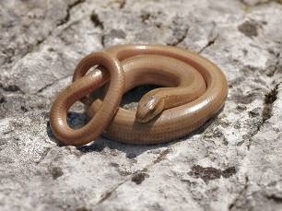
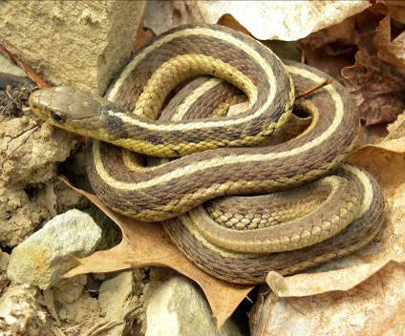
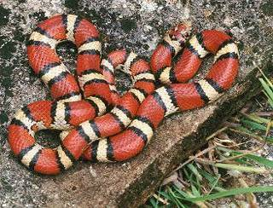
What Makes A Reptile?
Snakes

Slide 4
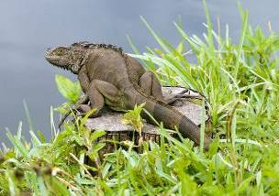
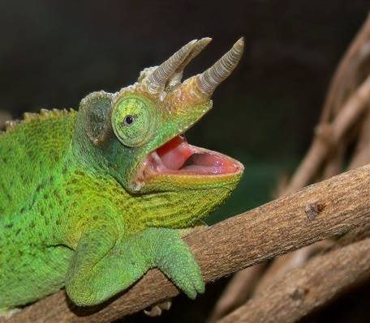
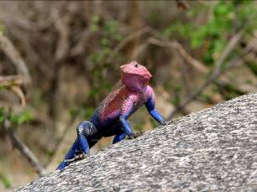
What Makes A Reptile?
Lizards

Slide 5
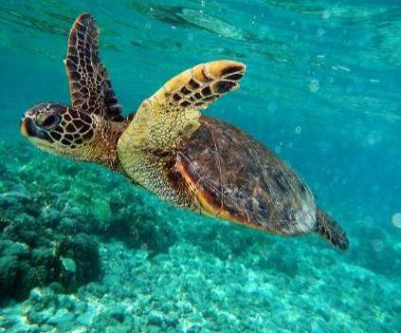
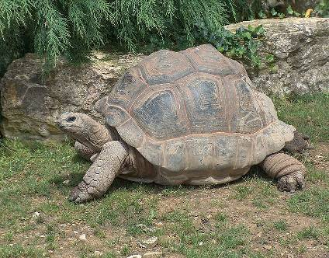
What Makes A Reptile?
Turtles and Tortoises

Slide 6
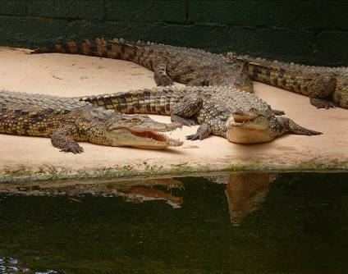
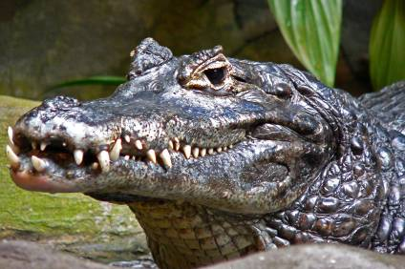
What Makes A Reptile?
Crocodilians

Slide 7
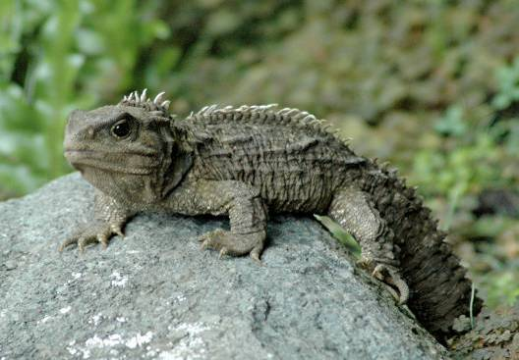
What Makes A Reptile?
Tuataras

Slide 9
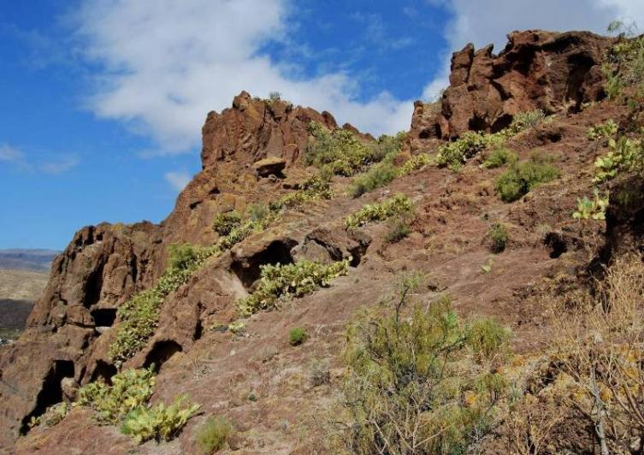
What Makes A Reptile?

Slide 10
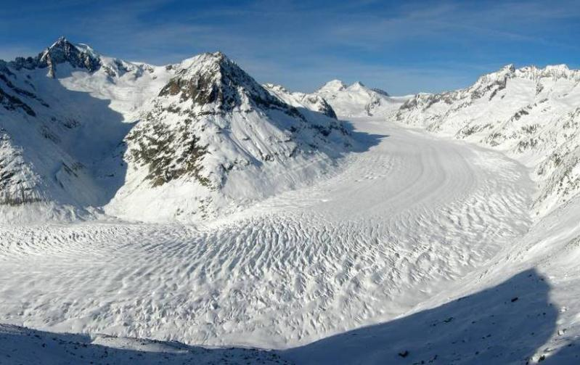
What Makes A Reptile?

Slide 12
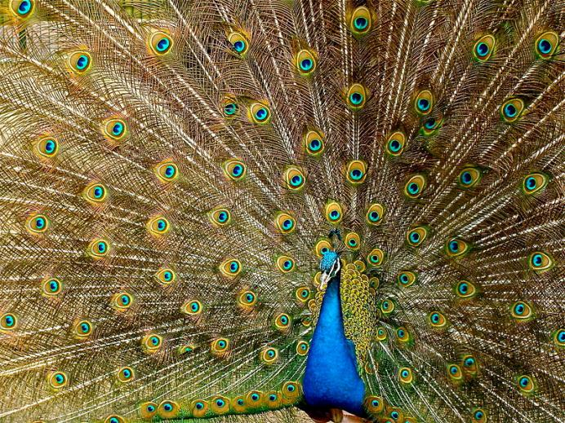
What Makes A Reptile?

Slide 13
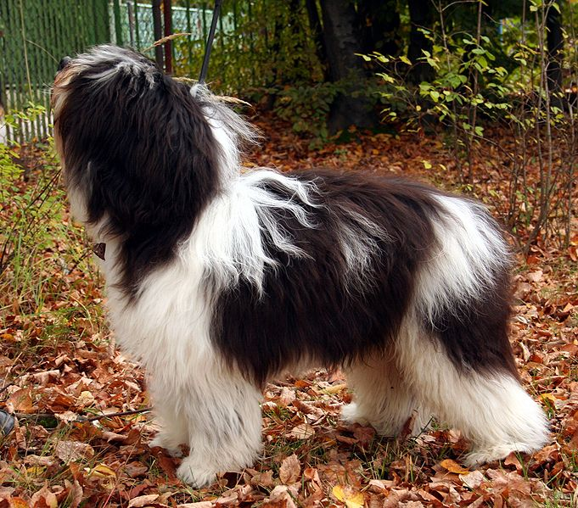
What Makes A Reptile?

Slide 14
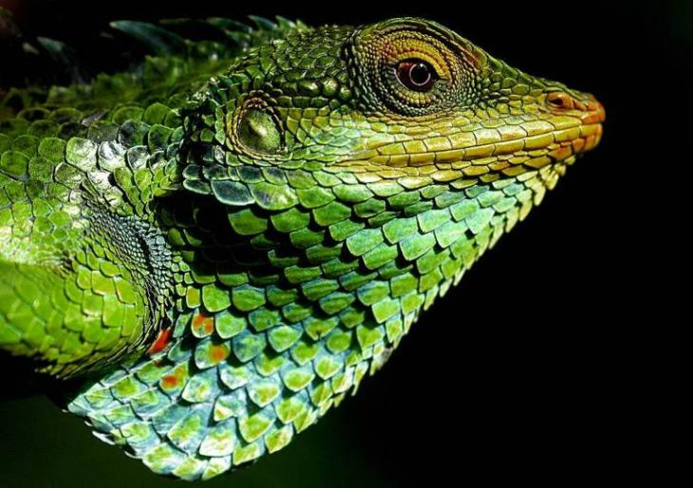
What Makes A Reptile?

Slide 16
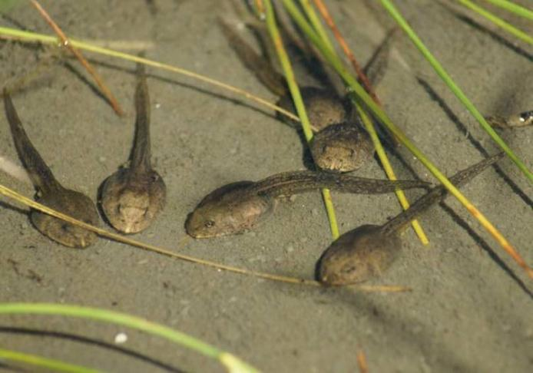
What Makes A Reptile?

Slide 17
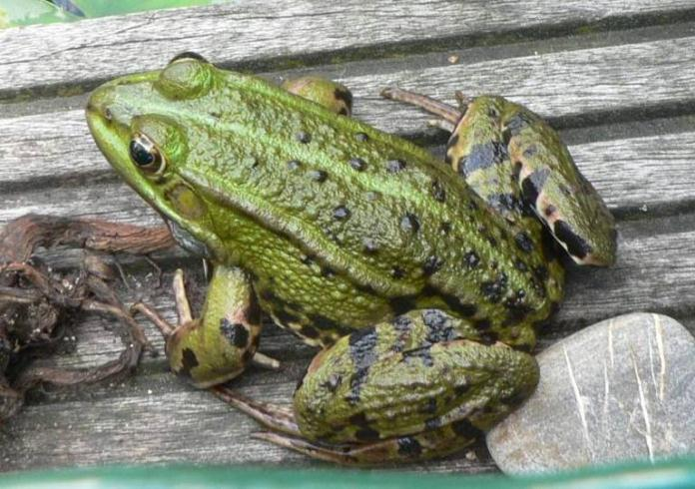
What Makes A Reptile?

Slide 19
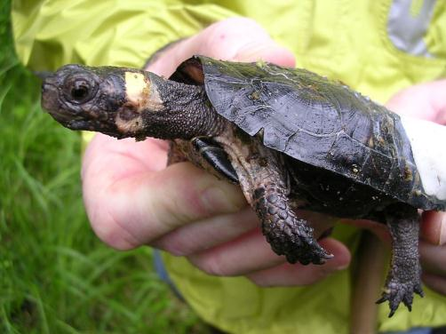
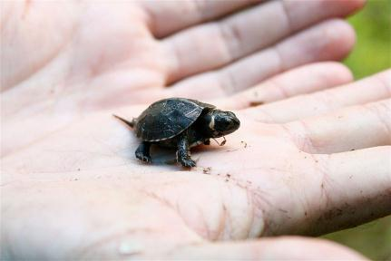
What Makes A Reptile?

Slide 21
All photos in the public domain except as follows:
Used under a Creative Commons Attribution 3.0 license:
“Tuatara” by KaresH
“Aletschgletscher-Eggishorn” (Aletsch glacier, Switzerland) by Tobias Alt
“Paonroue” (peacock) by Jebulon
“Polski owczarek nizinny” (Polish lowland sheepdog) by Pleple 2000
“Large-scaled forest lizard” by Babujayan
Thanks to all contributors, editors and proprietors of Wikimedia Commons

